Slide 1
Bayer Case Study
Sushmit Roy

Slide 2
Problem Statement
Bayer currently has a consumer data lake that brings together purchase transactions, media exposure and demographics/ purchase/ health attributes at an anonymized individual consumer level. Bayer would like to boost the effectiveness and efficiency of Digital campaigns using this data asset for a specific brand.
Explain the overall process that you will use to generate insights leading to improved Digital campaigns in a flow chart
What modeling and algorithms you will use specifically for purchase transactions, media exposure and consumer attributes?
What tools and techniques will you use to generate data-driven segments of audience?

Slide 3
Overall Process
Exploratory Data Analysis
Sales Transactions
Data Preprocessing
Segment customers based on consumer attributes
Attribution model
First touch and Last touch
Markov chain
Conversions across different media channel (segmented by demographics and health attributes)
Filter out customers based on existing customer segmentation
Stich the purchase data to media attributes (i.e., at cookie level)
Identify how many customers can be identified..
How many conversions can be identified
May be explore some supervised machine learning methods.
Notes:
May require more than one slide

Slide 4
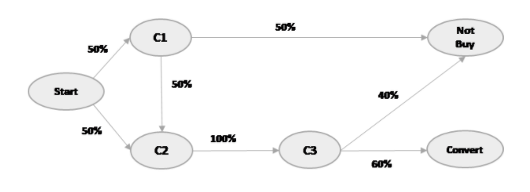
ATTRIBUTION MODEL
Customer can start the journey through one of the channels
Probability of conversion = P (C1 → C2 → C3 → Convert) + P( C2 → C3 → Convert) = 0.45

Slide 5
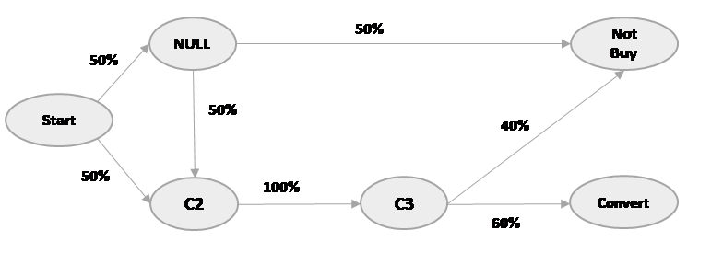
Markov Chains/Removal Effect
Markov chains maps the movement between customer journey and maps it to a probability
Customer journey can be considered as a chain in Markov graph.
Each vertex is a state and edges representing transition probability.
Probability of conversion removing C1 = 0.3
Removal effect = 0.3/0.45 = 0.666

Slide 6
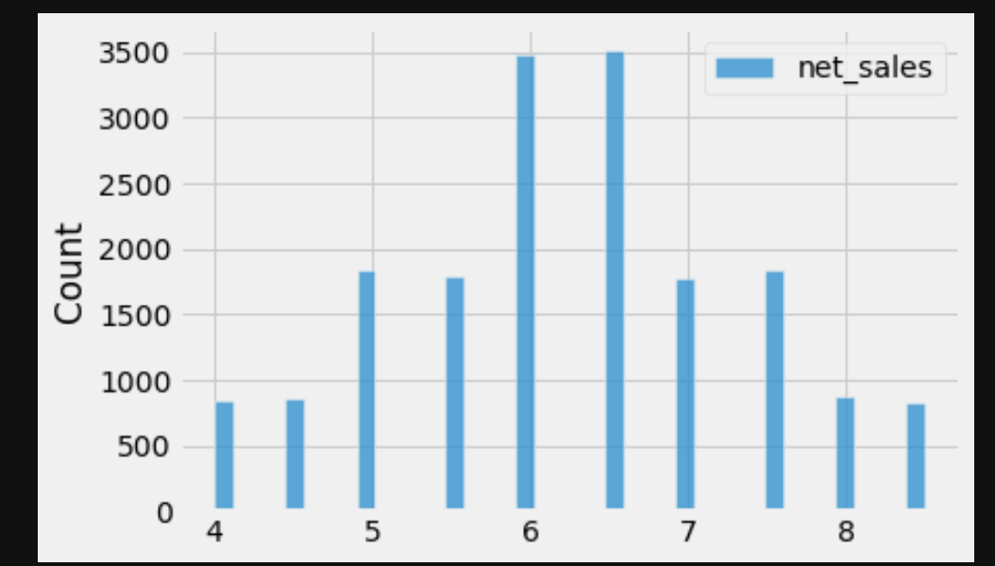
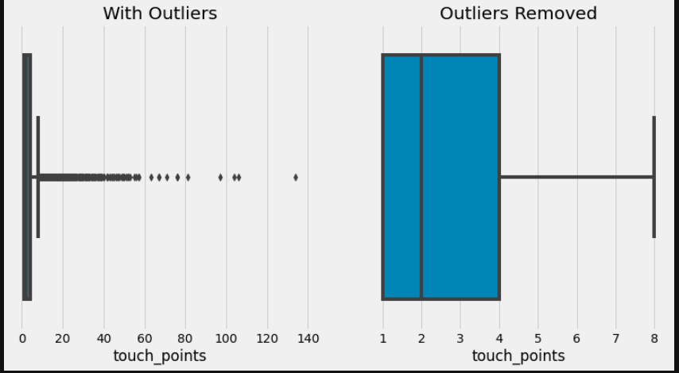
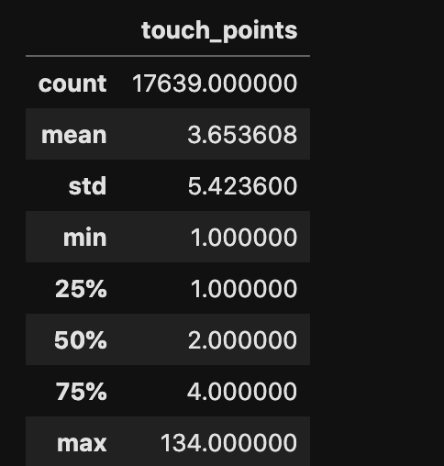
Exploratory Data Analysis

Slide 7
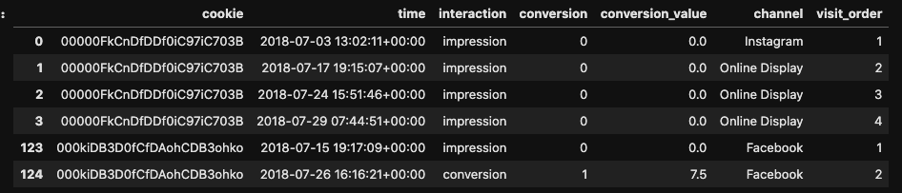

Data preprocessing

Slide 8
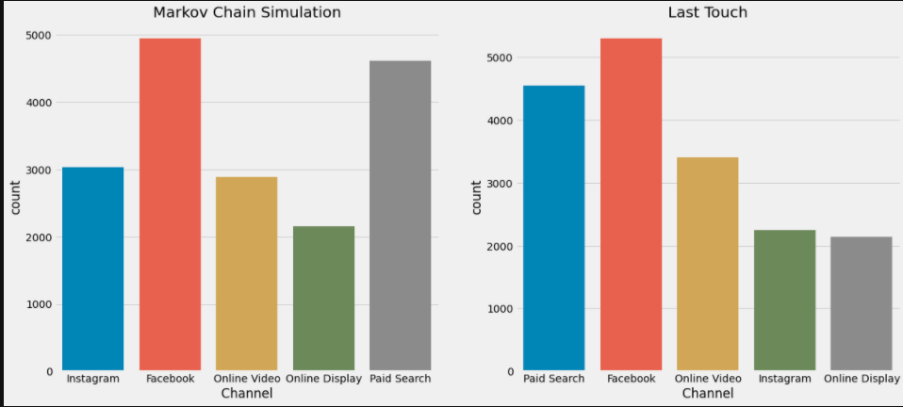
Results

Slide 9
Tools used
Jupyter Lab
Python
SQL/Pyspark

